Slide 1

USWDS Monthly Call
October 2023

Slide 2

Hi!
Thanks for being here!

Slide 3
Agenda
Site launches
Product updates
Operationalizing user research
Q&A

Slide 4
Site launches

Slide 5
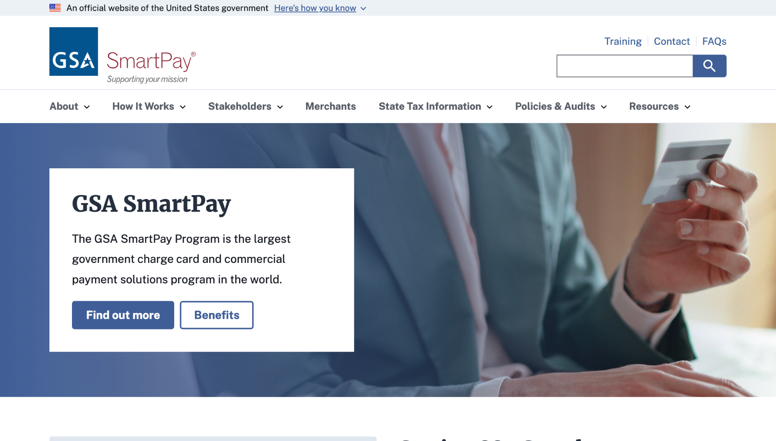
GSA SmartPay
smartpay.gsa.gov

Slide 6
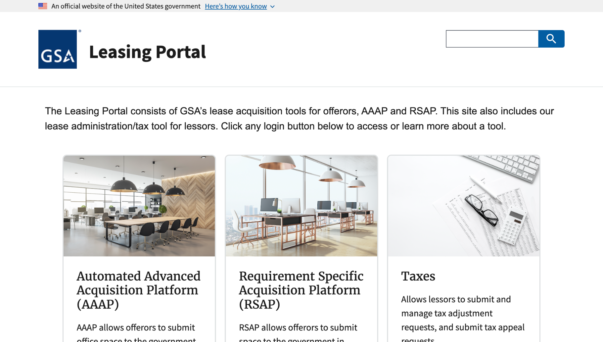
GSA Leasing Portal
leasing.gsa.gov

Slide 7
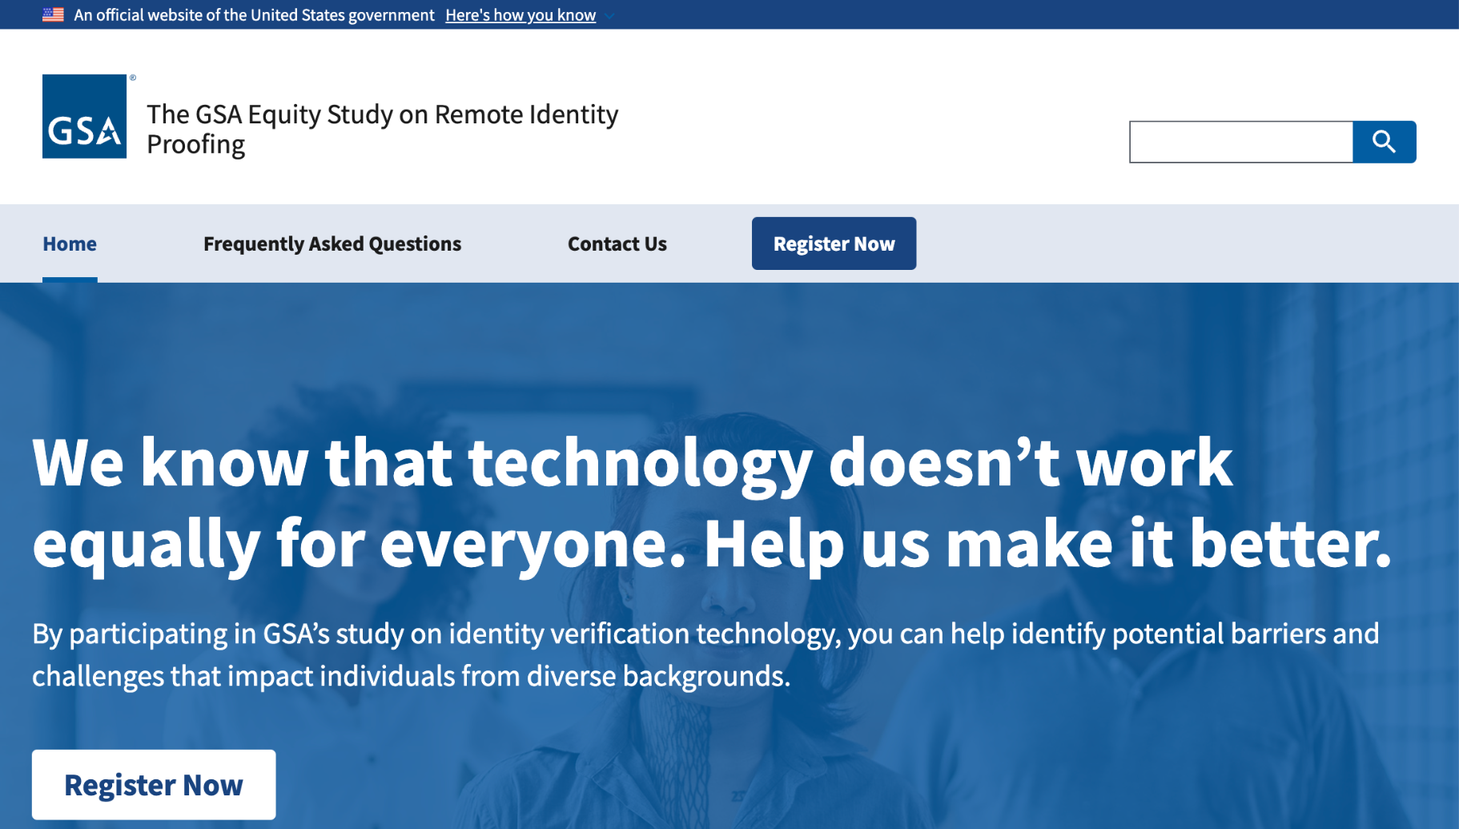
The GSA Equity Study on Remote Identity Proofing
identityequitystudy.gsa.gov

Slide 8
Great work!

Slide 9
Product updates

Slide 10
USWDS 3.7.0
Accessibility and interactivity

Slide 11
Key improvements in USWDS 3.7.0
Improved JAWS keyboard navigation in Date picker
Improved keyboard navigation in Range slider
Added units data to Range slider
Allow custom language content in File input
Improved teardown of Modal in dynamic applications
Improved Banner initialization
Add an X social media icon

Slide 12
USWDS 3.7.0
Coming soon

Slide 13
Open discussion HTML Sitemaps
github.com/uswds/uswds/discussions/5561

Slide 14
Open discussion WCAG 2.2
github.com/uswds/uswds/discussions/5569

Slide 15
Operationalizing user research
A focus on people with disabilities

Slide 16
We have a research page?

Slide 17
Oh.

Slide 18
“User research is a core aspect of USWDS as it’s our main source of feedback and inspiration for future product development.”
Yes.

Slide 19
“One of our challenges is knowing who is interested in being part of our user research.”
Yes.

Slide 20
“One of the most consistent ways we have collected feedback has been by conducting interviews with digital service teams.”
Yes.

Slide 21
But research has been a challenge

Slide 22
What we’ve done is a hodgepodge
Building from trusted sources
Peer review with community
Occasional focused usability research
User acceptance testing before launch
Open source community feedback

Slide 23
The reality: We need to be more proactive

Slide 24
Our research is only getting older

Slide 25
Our need: Conduct inclusive research

Slide 26
Our roadmap: Conduct inclusive research

Slide 27
M-23-22: Conduct inclusive research

Slide 28
So how do we
conduct inclusive research?

Slide 29
Now is the time

Slide 30
USWDS is maturing as a product

Slide 31
Teams expect more from us

Slide 32
Our hypothesis
If we can get things right for users with disabilities, we’re on the right track.

Slide 33
Accessibility testing and
usability research

Slide 34
Enough research to know where we needed to ask more questions

Slide 35
Compensation
Recruiting
PRA and Privacy

Slide 36
Common challenges teams face

Slide 37
We needed help
getting over the finish line

Slide 38
We needed help
developing repeatable processes

Slide 39
Robert Jolly
he/him
Product Manager and Accessibility Advocate
10x

Slide 40

10x is a GSA program that explores ideas that can improve the public’s experience with the federal government.

Slide 41
Enabling Government Research Operations
A 10x Phase 3 Project

Slide 42
What 10x has learned

Slide 43
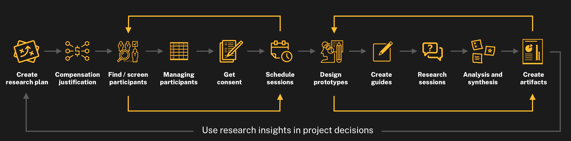
Research cycle for teams doing research with the public

Slide 44
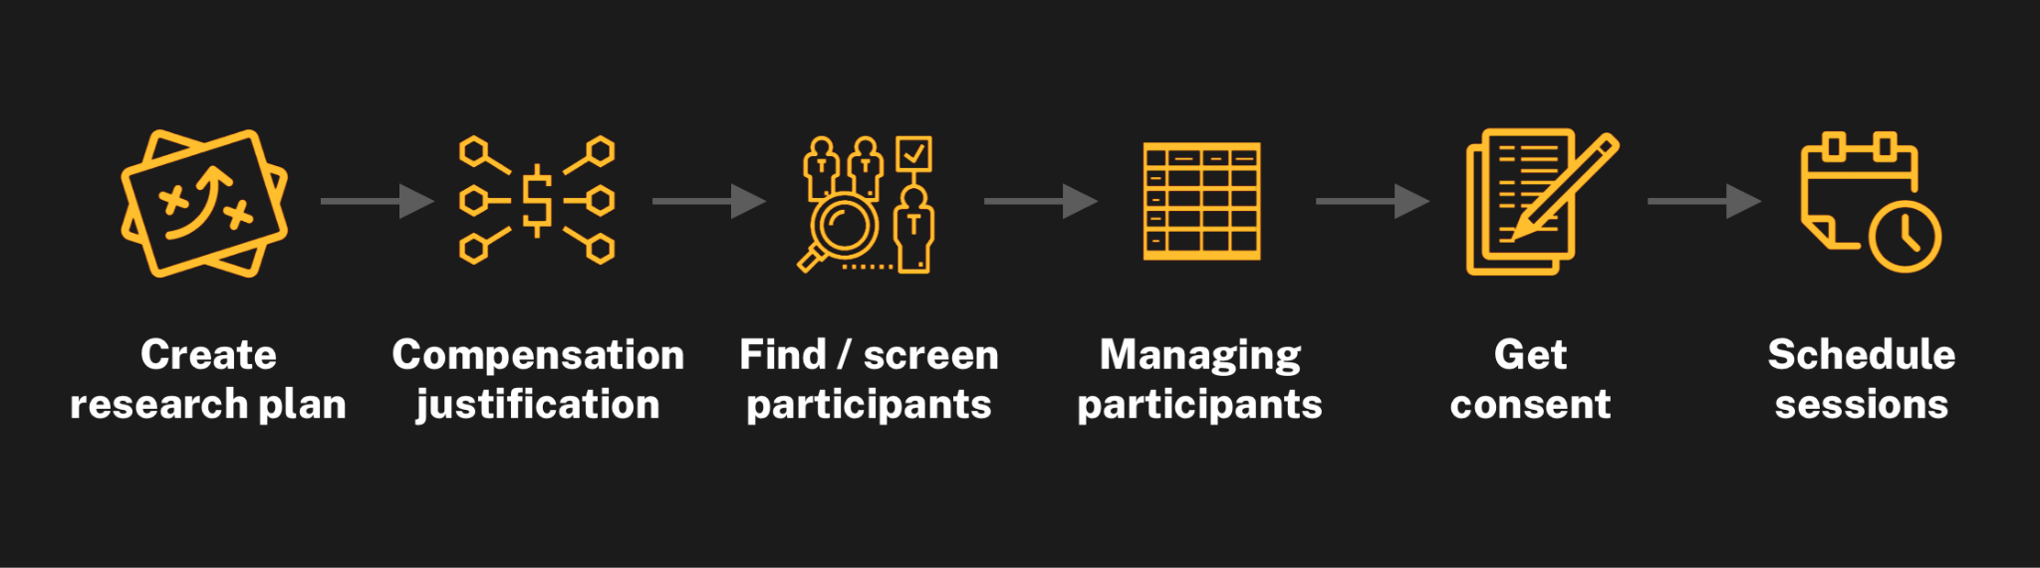
Operational steps must be completed before a single research session

Slide 45
Barriers to research
Difficulty recruiting participants
No readily available means of recruiting research participants
No coordinated relationships with community groups
PRA implications for screening
Managing participants
Labor intensive
PII and security concerns about what data is stored and where
Lack of access to tools (like relational databases) to track across projects
Compensation
Additional costs to teams and partners
Implications for budgeting, project planning, and interagency agreements
New process in early stages of adoption and guidance
Scheduling and logistics
Time consuming, manual effort
Limited approved tools for appointments and calendar coordination

Slide 46
It takes a lot of time and effort to do research with the public.

Slide 47
…so often, teams just don’t do the research.

Slide 48
We need a
sustainable process

Slide 49
Research operations is all the work that goes into research that isn’t research.

Slide 50
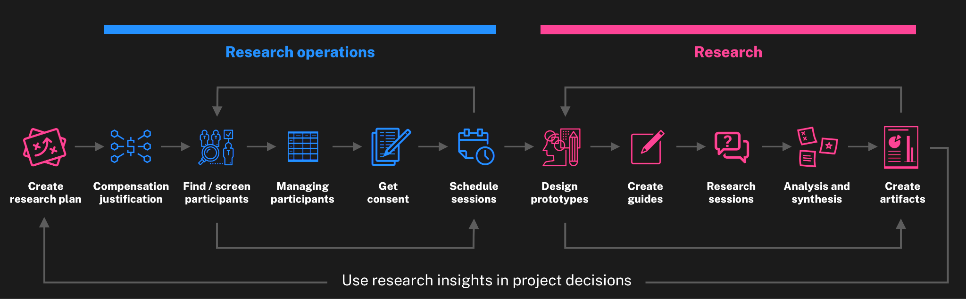
Research operations in the research cycle

Slide 51
An opportunity to standardize and simplify
In order to get necessary insights from the public, we need to standardize and simplify the way we do research with the public.
Recruitment: Identify and recruit participants
Compensation for participants: Standard rates and means of compensation
Scheduling: Coordination of public and government teams
Policy clarity: For issues of privacy, paperwork reduction, and data retention
Knowledge management: Repositories and processes for sharing findings

Slide 52
Replicating this process

Slide 53
Complementing existing work

Slide 54
Could this be a service?

Slide 55
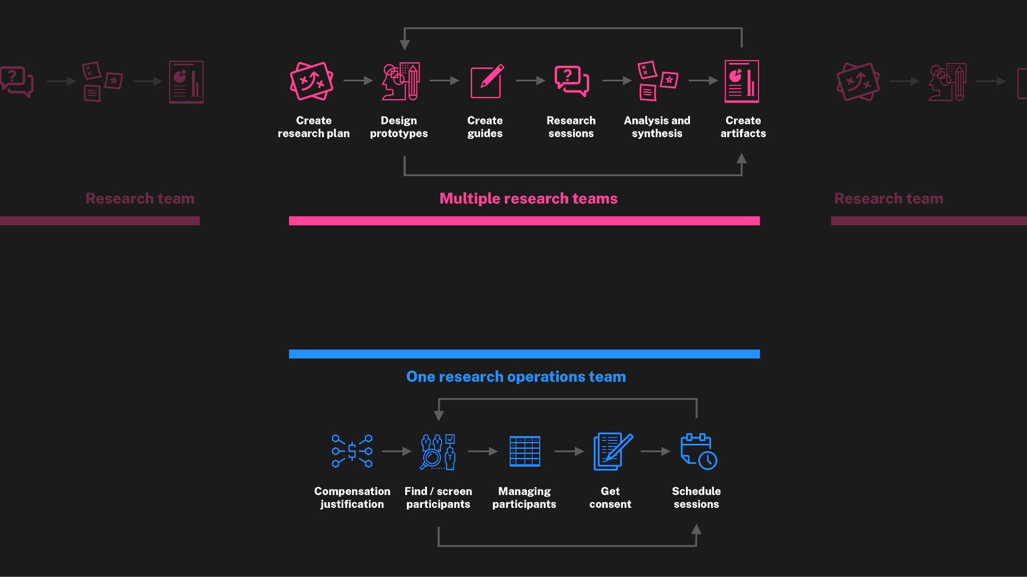
Future state: One research ops team supports multiple research teams

Slide 56
Do you have an idea for 10x?
Submit your ideas at 10x.gsa.gov

Slide 57
Supporting the people who use what we build

Slide 58
Jacline Contrino
she/her
UX Researcher, Contractor
USWDS

Slide 59
Research goals
Test drive the process of testing.
Assess performance of components with visually impaired people who use assistive technology.

Slide 60
Building on past research

Slide 61
What we tested
Accordion
Character count
Combo box
Date picker
File input
Input mask
Step indicator
Validation

Slide 62
Method
1 hour 20 min via Zoom
Semi-structured interview
Fictional scenario
Participants interacted with a semi-functional prototype while thinking-out-loud
Remote, moderated

Slide 63
Participants
3 blind, 2 with some vision
3 screen reader-only users
1 screen reader + screen magnification
1 screen magnification only
Experience with using AT varied widely
5 total

Slide 64
Recruitment

Slide 65
PRA & Privacy Act

Slide 66
Compensation

Slide 67
Findings

Slide 68
Results
Accordion No friction
Character count Minor friction
Combo box Most friction
Date picker Most friction
File input Minor friction
Input mask Most friction
Step indicator No friction
Validation Most friction
Links styled as buttons Needs more research
Banner Needs more research

Slide 69
Most friction

Slide 70
Input mask
Input mask doesn’t give adequate feedback.
When participants enter disallowed characters, they don’t receive feedback that something is wrong.
Disallowed characters disappear after entry, but that’s not apparent to participants.

Slide 71
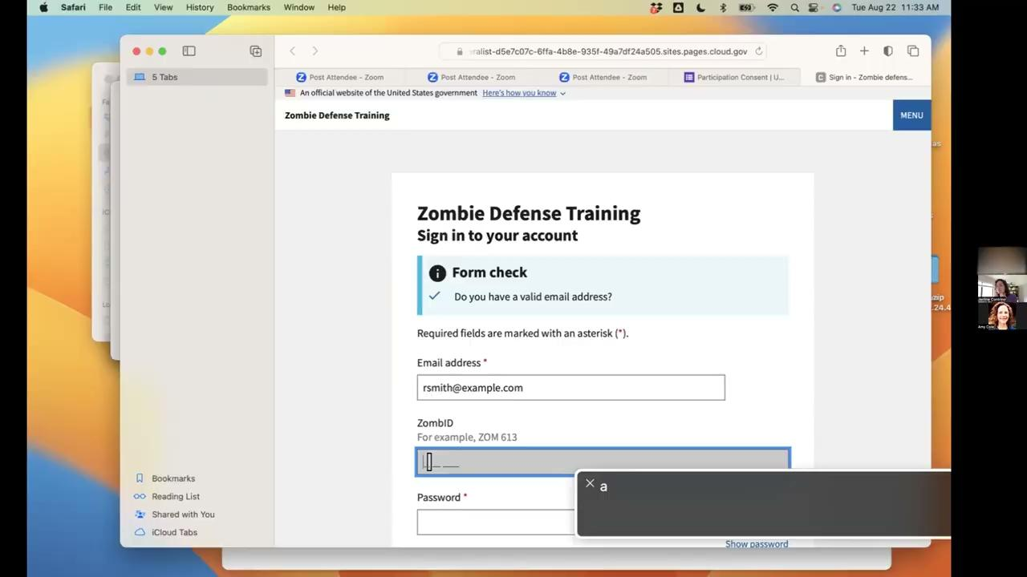
Input mask clip

Slide 72
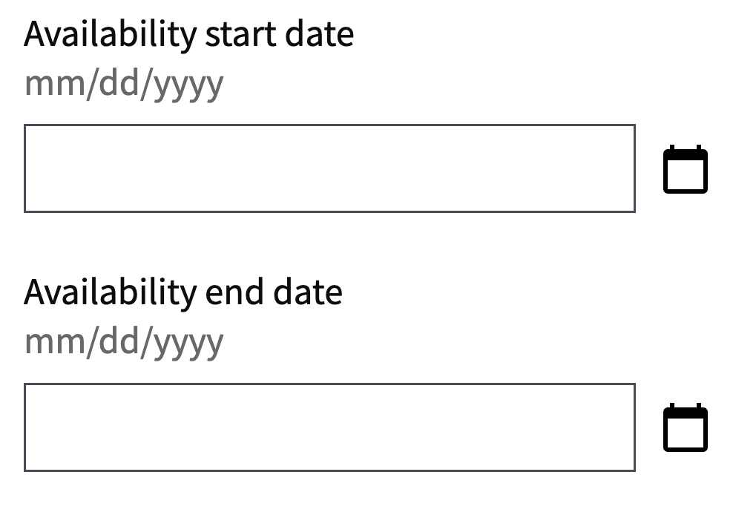
Date picker
Keyboard controls didn’t work as expected.
Manual-input formatting wasn't clear.
It’s unclear if participants have to enter date slashes manually.
There’s no feedback when participants enter an incorrect format, like omitting leading zeros (i.e. 10/1/2023 instead of 10/01/2023)

Slide 73
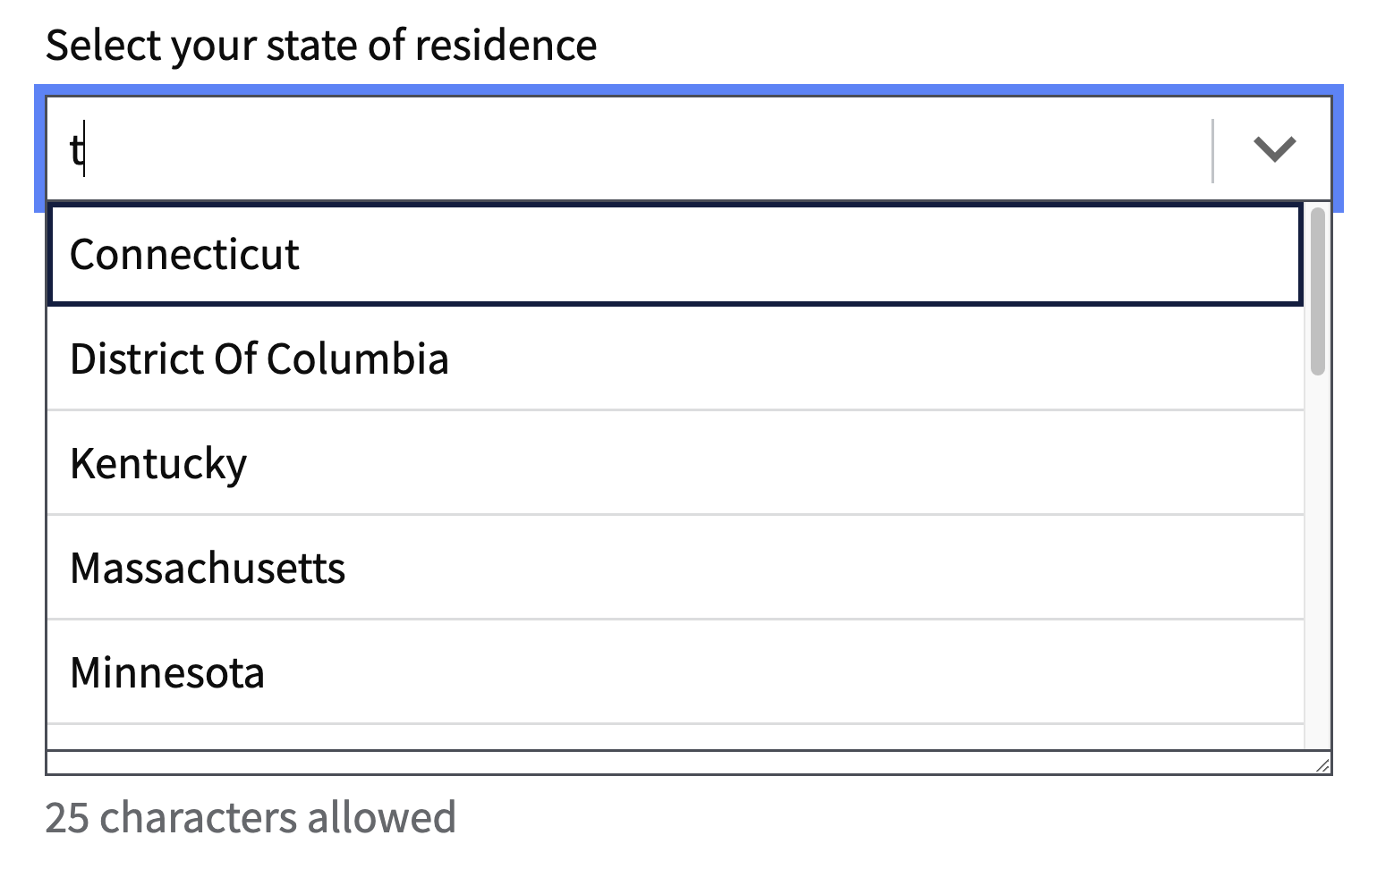
Combo box (1 of 2)
Combo box interaction didn’t match expectations.
Participants expected to be able to use first-letter navigation to get to their selection.
They expected that entering T would show states starting with T first (like Tennessee) instead of states that start with other letters that include T later in the string (like Connecticut).

Slide 74
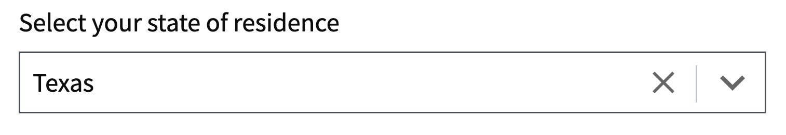
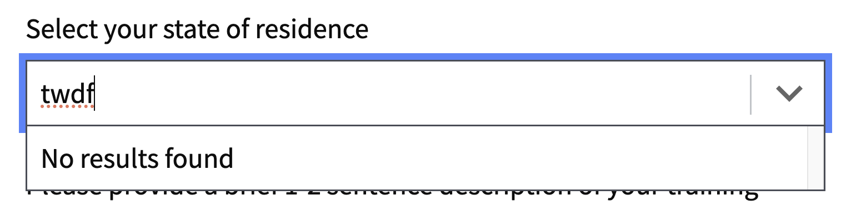
Combo box (2 of 2)
The function of the X button isn’t obvious.
A participant thought the X button was deselect instead of clear.
It’s good to get feedback when there are no results.
One person liked that when you enter something wrong, it gives feedback of No results found.

Slide 75
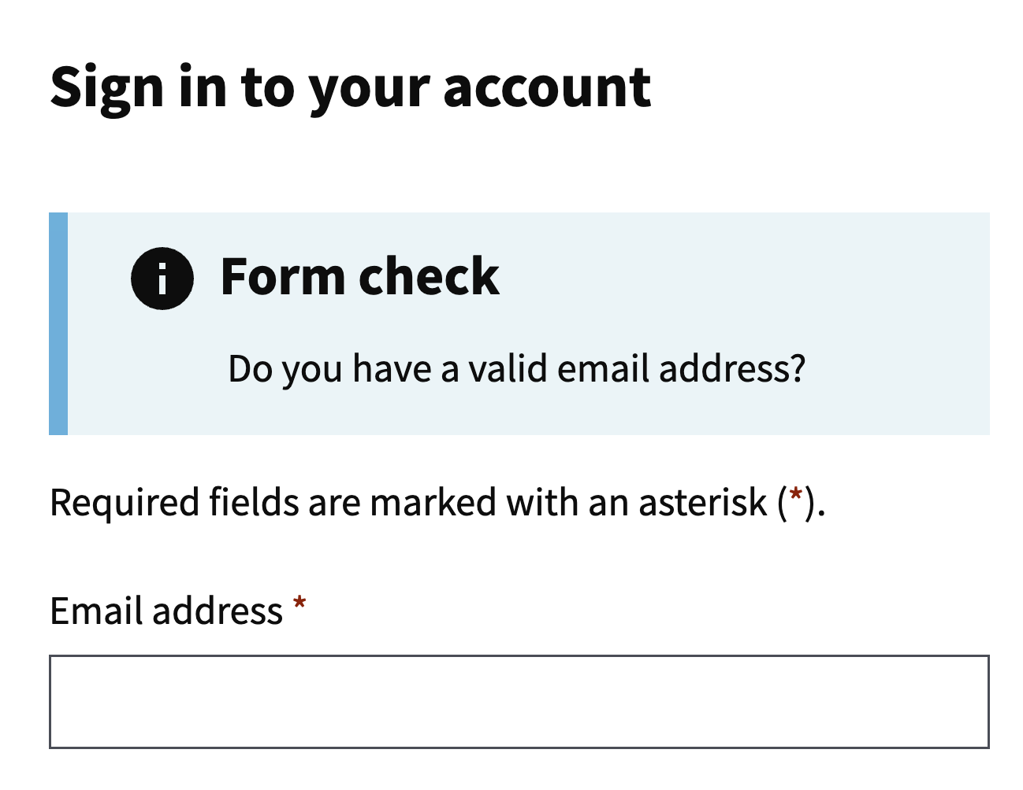
Validation (1 of 2)
A separate validation component isn’t the expected spot for validation information.
Participants wondered what the purpose of a separate validation message. They expect inline validation or an error message at submission.

Slide 76
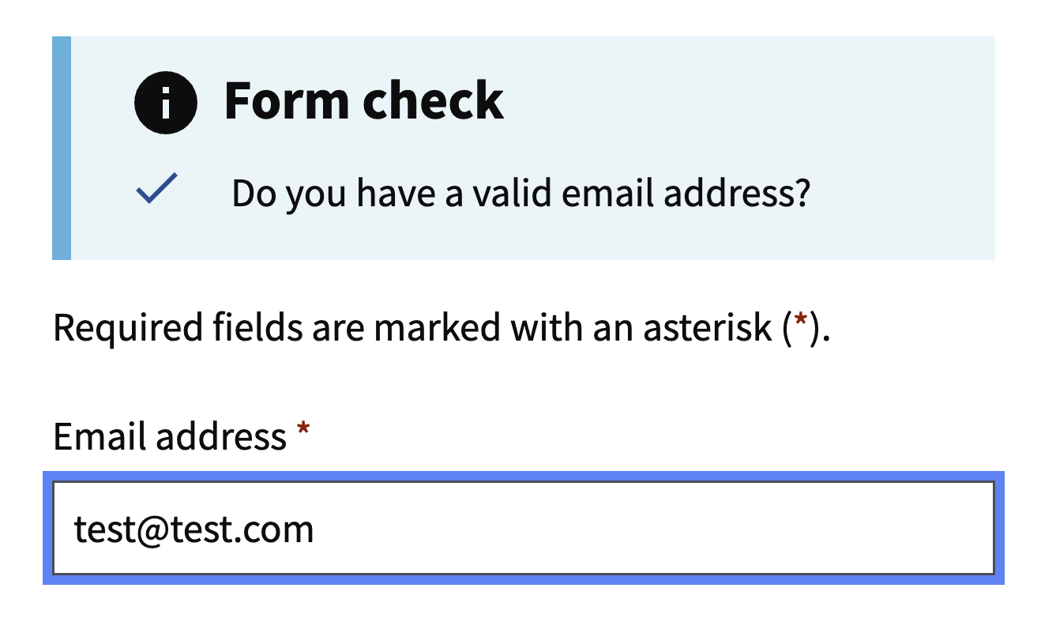
Validation (2 of 2)
Validation checkmarks don’t give meaningful feedback.
No one noticed the state changing (the checkmark) when they entered valid data.

Slide 77
Minor friction

Slide 78
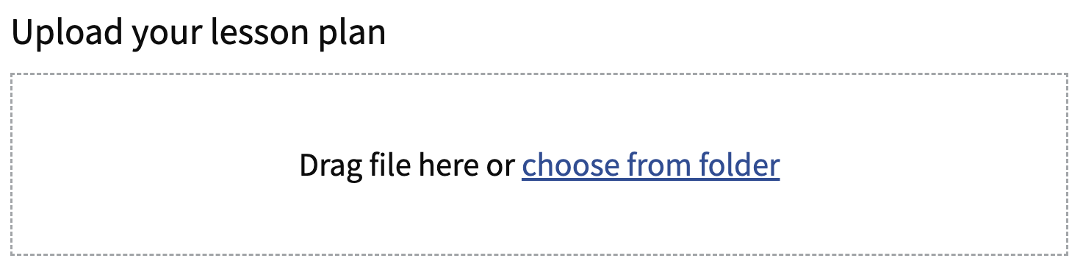
File input
This component performed well.
Possible enhancements:
Offer more instruction on how to select a file.
Make Drag file here and No file chosen separate elements.

Slide 79
Character count (1 of 3)
“
Oh, it worked really well. It was… giving me updates. It wasn't like being overzealous with it and trying to tell me how many characters there were every single time I typed a character like it was waiting until it was done. I think that works pretty well.”
This component performed well.
Most participants liked how it offered delayed feedback, and that it let you know when you’ve gone over the character limit.
”

Slide 80
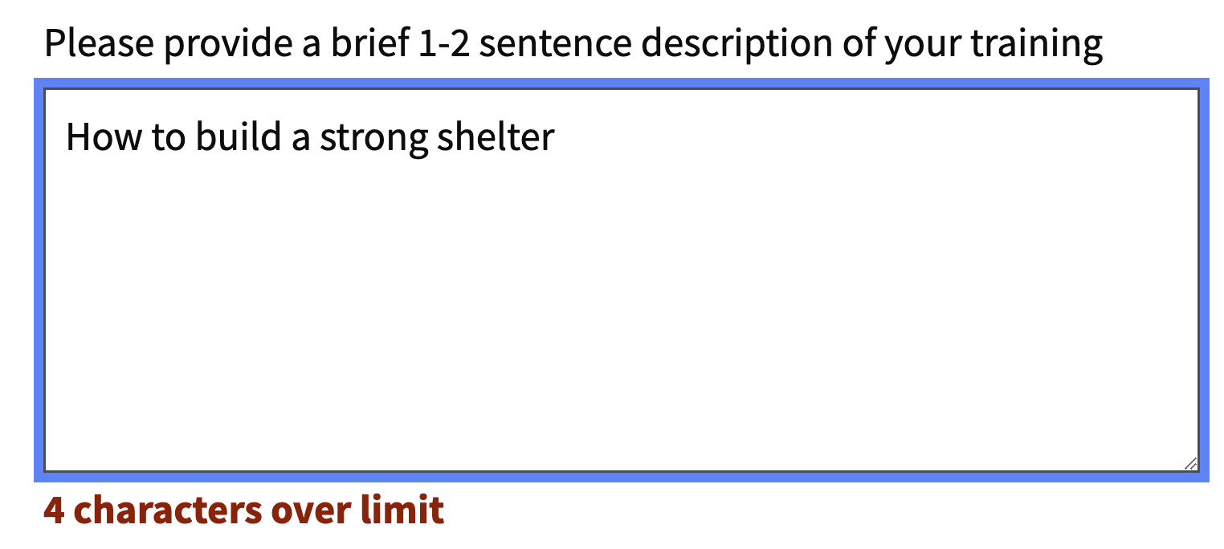
Character count (2 of 3)
Participants prefer hard cutoff.
Our participants preferred to be prevented from typing once they have gone over the character limit.

Slide 81
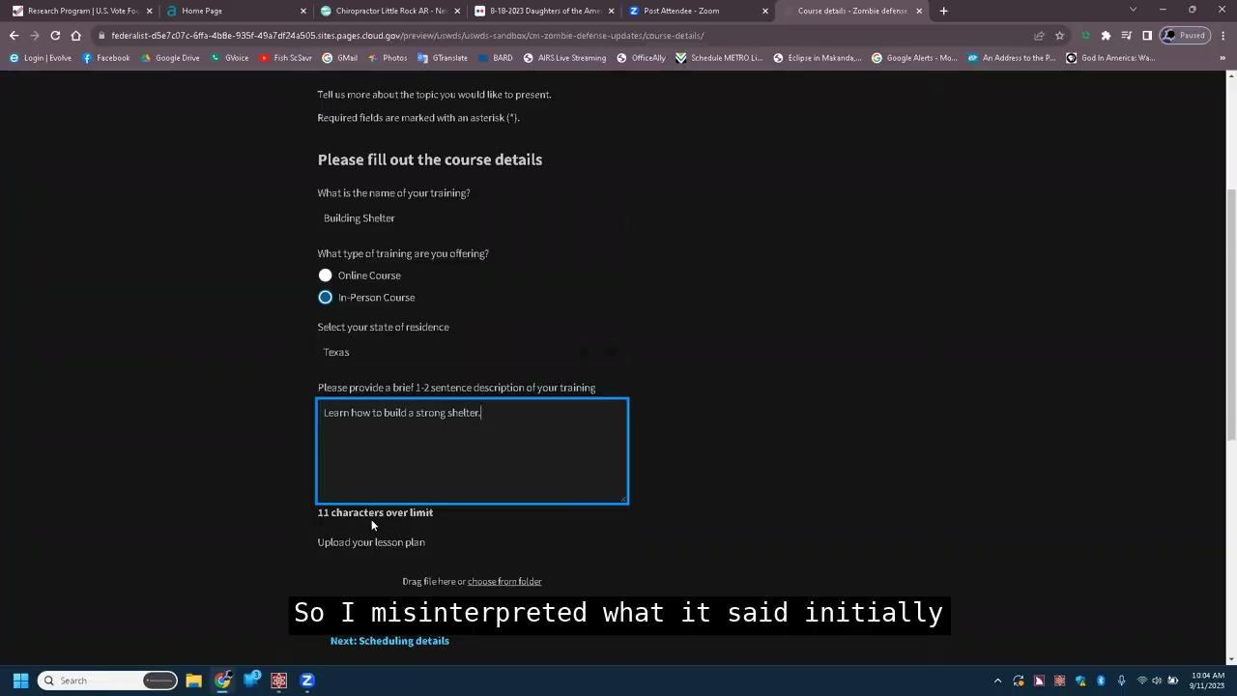
Character count (3 of 3)
More visual cues needed.
The screen magnification user needed more visual cues when she’s gone over the limit by outlining the box in red and/or stopping her from typing.

Slide 82
No friction

Slide 83
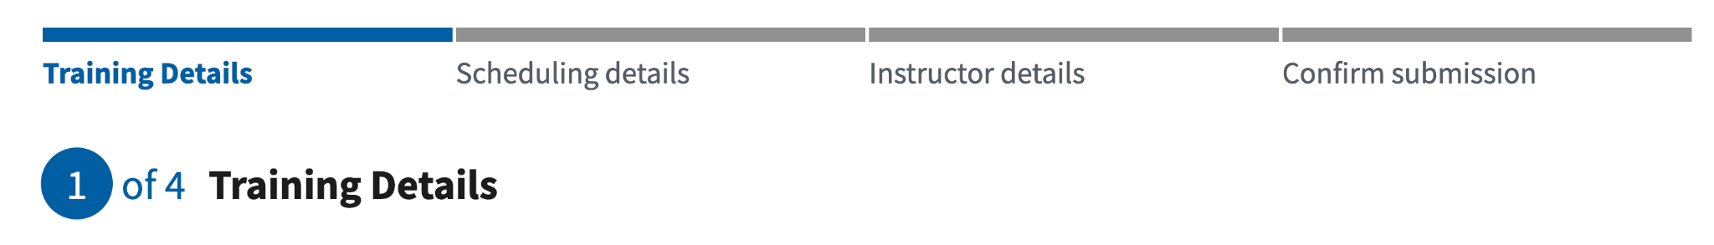
Step indicator
This component performed well.
For 4 out of 5 participants, it did its job of orienting users to where they were in the form and how much was left.

Slide 84
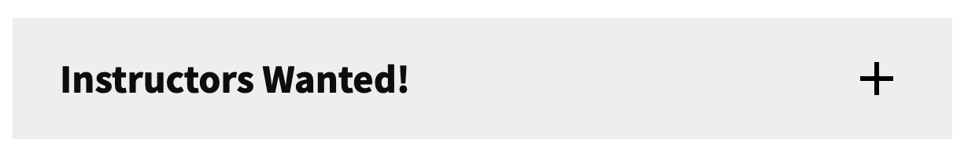
Accordion
This component performed well.
It met user expectations and all participants were able to successfully interact with it.

Slide 85
Where we need more research

Slide 86
Links styled as buttons

Slide 87
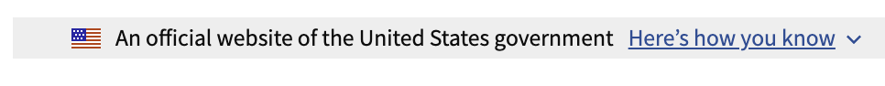
Banner
“
It can be confused for navigation.
“I was thinking [it] might be more menu options. Because usually any buttons that are collapsed at the top of the page like that are usually menu, navigation things.”
There can be button/link confusion.
A participant with some vision commented that it was an example of something labeled as a button that wasn’t a true button.
”

Slide 88
Dark mode and external plugins

Slide 89
Shared findings, discussed, and created GitHub issues

Slide 90
One GitHub issue consolidating all findings per component

Slide 91
Broke out individual findings and recommendations into separate issues

Slide 92
Anne Petersen
they/them
Experience Design Lead
USWDS

Slide 93
What’s next?

Slide 94
Maturing our process

Slide 95
Our process is (part of) our product

Slide 96
The design system: Not just a commonality machine but a change machine

Slide 97
Our polestar
We help government teams align, design, and keep their websites and services up to date

Slide 98
What are we doing?

Slide 99
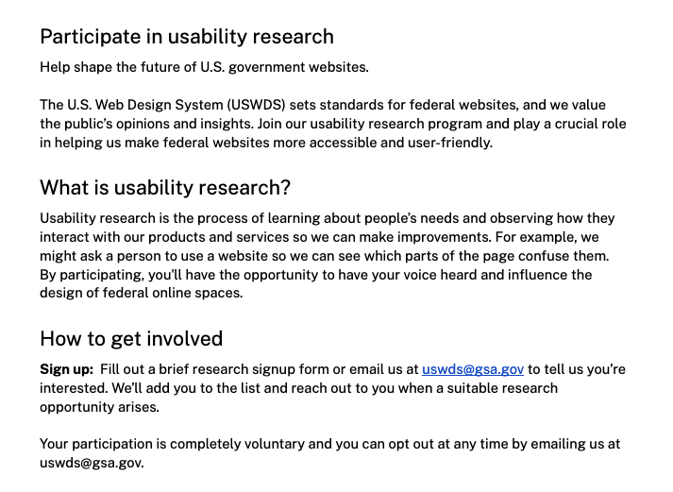
Future recruiting page
We’re drafting a new page for research participant recruitment

Slide 100
Regular research cadence

Slide 101
Publishing

Slide 102
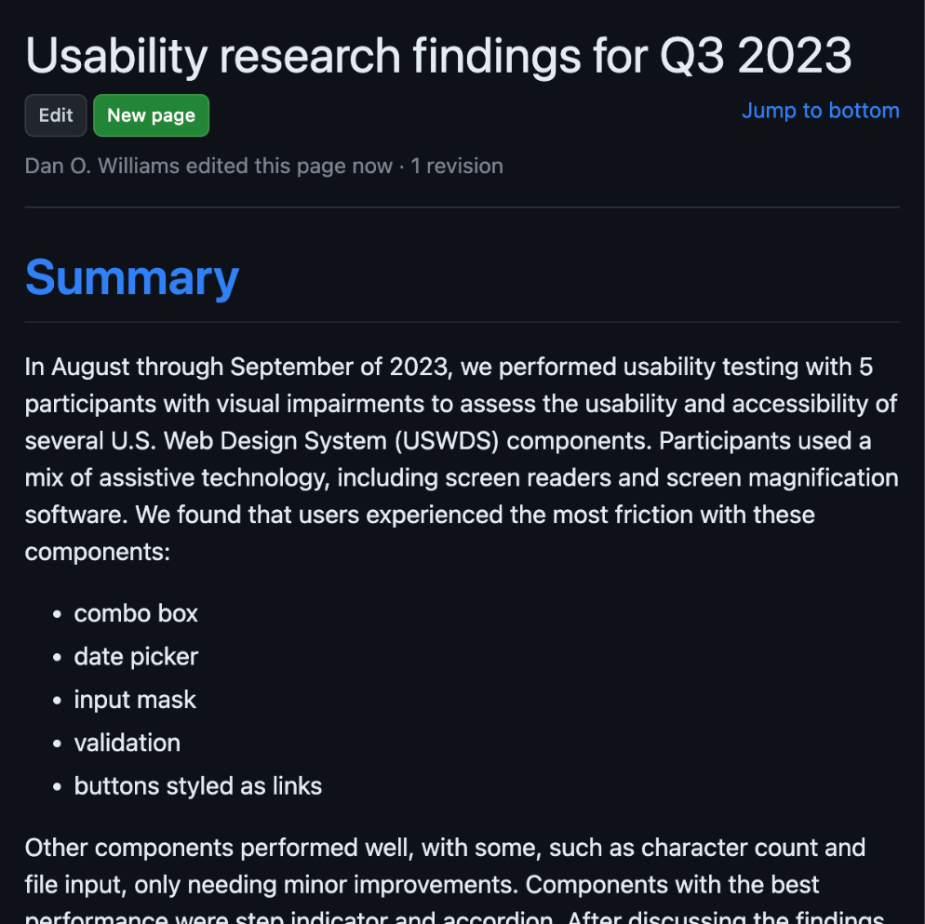
Usability
research findings
We’re publishing findings to our repository’s wiki, linked from relevant components

Slide 103
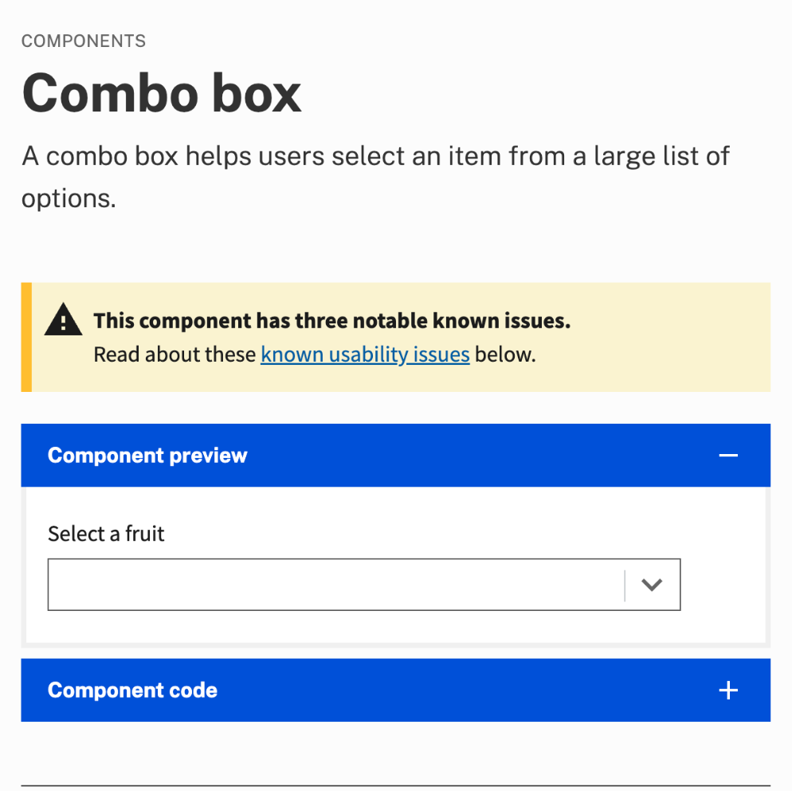
Component known issues
Each component with notable known issues will have an alert at the top of the page

Slide 104
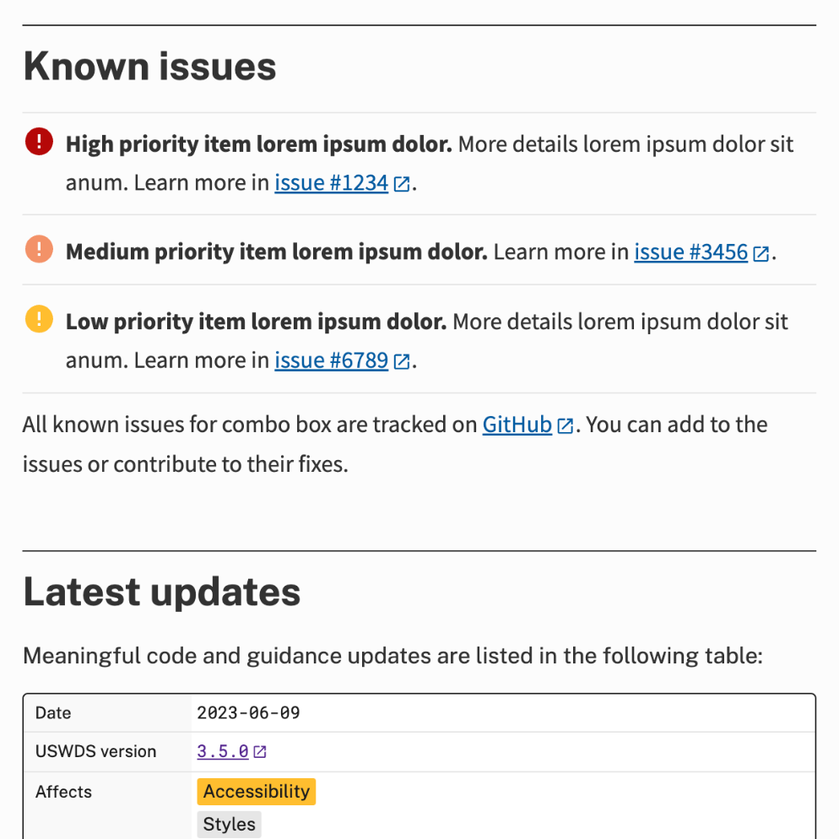
Component known issues details
We’ll collect notable known issues in a plain-language list, with a link to the issue in our code repository

Slide 105
Everyone should be able to make informed decisions

Slide 106
Planned for release

Slide 107
Establish ongoing accessibility-focused usability testing
Operationalize usability testing with people with disabilities as a sustainable, repeatable process that other teams could adapt
Why are we doing this?
To better understand how our components perform with real users, especially those with disabilities
To be proactive when it comes to component usability
To be able to share our process with other teams that want to improve their own usability testing capacity
Milestones
First: Develop a process for recruitment, management, compensation, and testing.
Next: Pilot this process and develop relationships with communities.
After: Perform ongoing testing and share our process with our own community.
Total: 6 months (2 months remaining)

Slide 108
Bit by bit.
Improvement by improvement.

Slide 109
Onward

Slide 110
Q&A

Slide 111
Next month
November: Introducing component proposals
#uswds-public
github.com/uswds
designsystem.digital.gov

